Slide 1
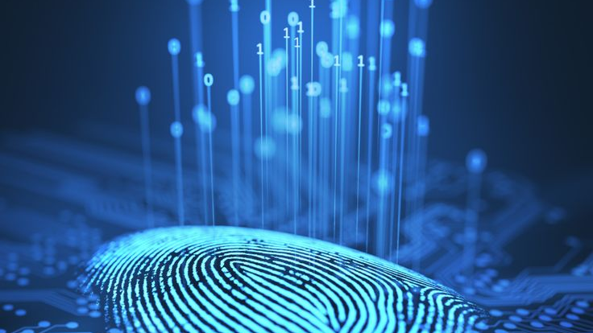
Digital
Forensic Investigations
Mobile Forensic
Notes:
To use this title animation slide with a new image simply 1) move the top semi-transparent shape to the side, 2) delete placeholder image, 3) click on the picture icon to add a new picture, 4) Move semi-transparent shape back to original position, 5) Update text on slide.

Slide 2
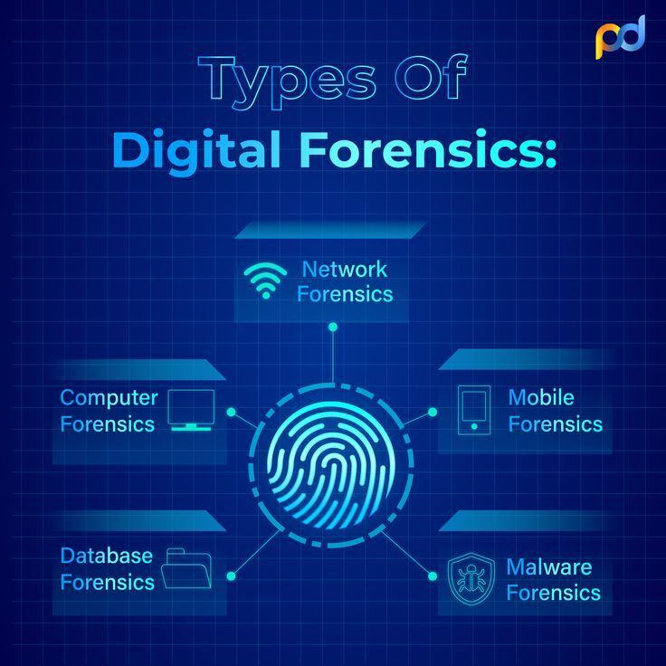
Types of Digital Forensics:
Mobile Forensics

Slide 3
INTRODUCTION
Mobile devices can contain
a lot of user information, such as call logs, contacts, messages, photos, videos, browsing history, geolocation data, and app data, which can be useful for criminal investigations, cybersecurity analysis, and data recovery efforts.
Digital mobile forensics is a branch of digital forensics that deals with extracting and analyzing data from mobile devices, such as smartphones, tablets, GPS units, and wearables.
mobile forensics is also challenging
as mobile devices are constantly changing and updating, and have different levels of encryption and security that can prevent access to the data.
Mobile forensics requires specialized tools and techniques to acquire and process the data in a forensically sound manner, while preserving the integrity and admissibility of the evidence.

Slide 4
ANDRELLER
is software utility with a collection of forensic tools for smartphones. It performs read-only, forensically sound, non-destructive acquisition from Android devices.
Selection of individual database decoders for Android apps
Decryption of encrypted WhatsApp archived databases
Automated data extraction and decoding
Data extraction of non-rooted without devices by Android Backup, Data extraction with root permissions
Data parsing and decoding for Folder structure
Tarball files (from nanddroid backups), and Android Backup (backup.ab files)

Slide 5
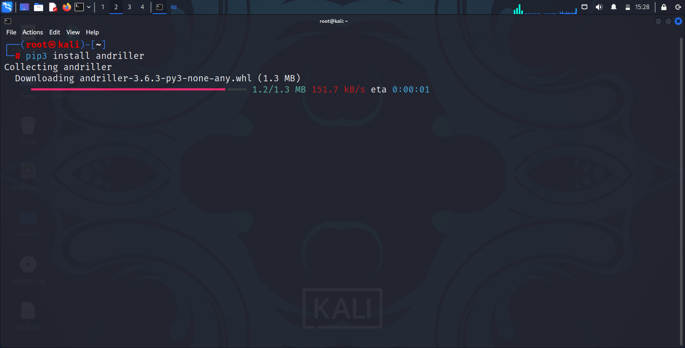
Download ANDRELLER
!

Slide 6
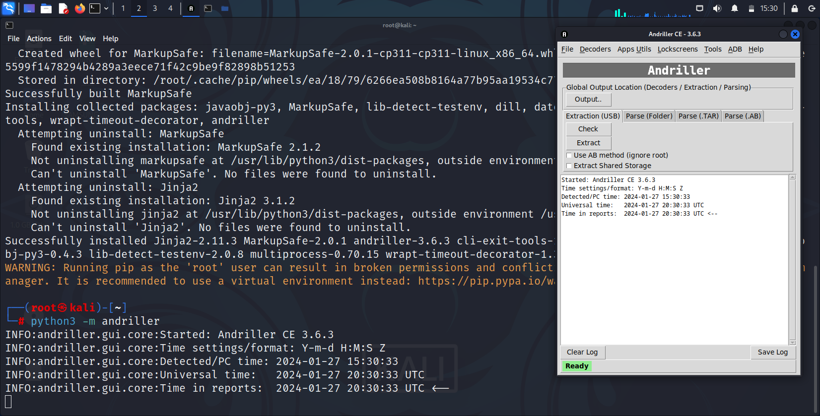
Download ANDRELLER
!

Slide 7
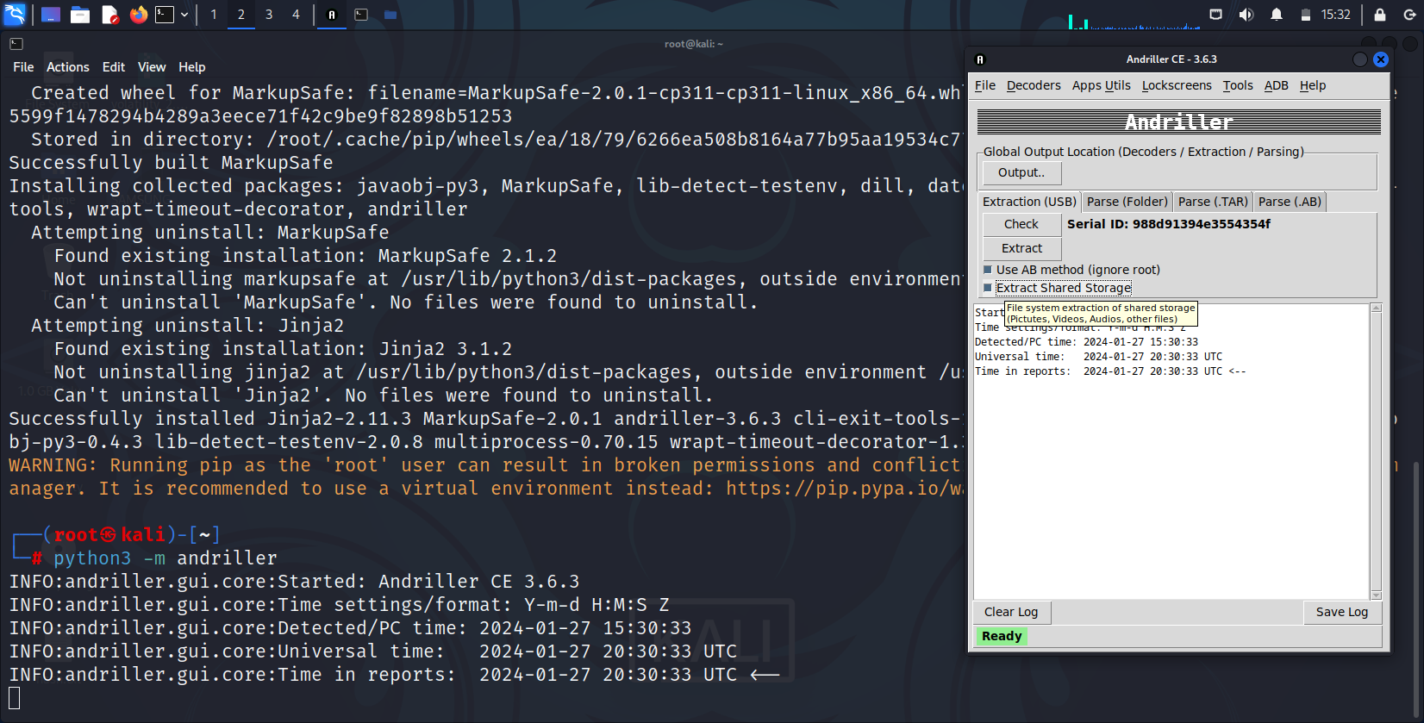
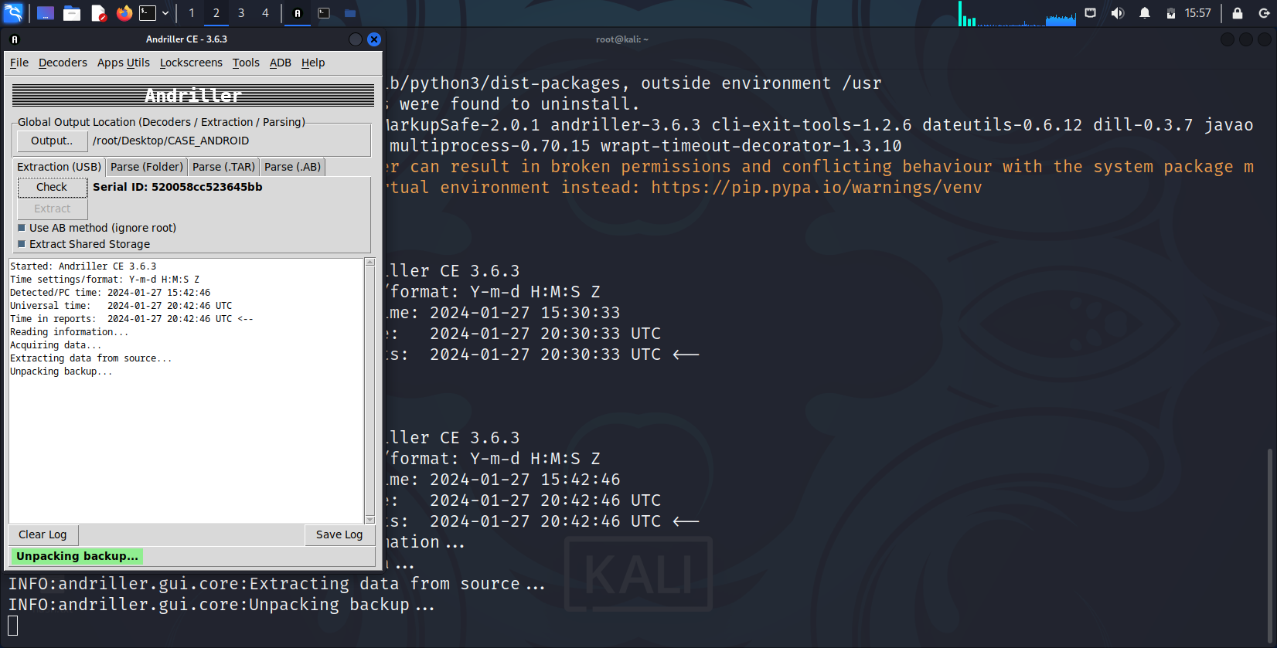
Using
ANDRILLER

Slide 8
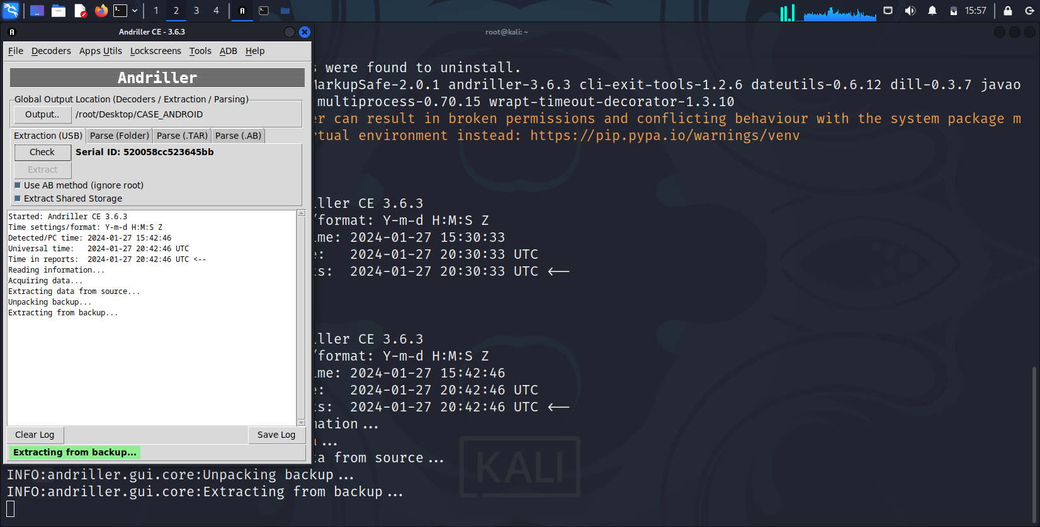
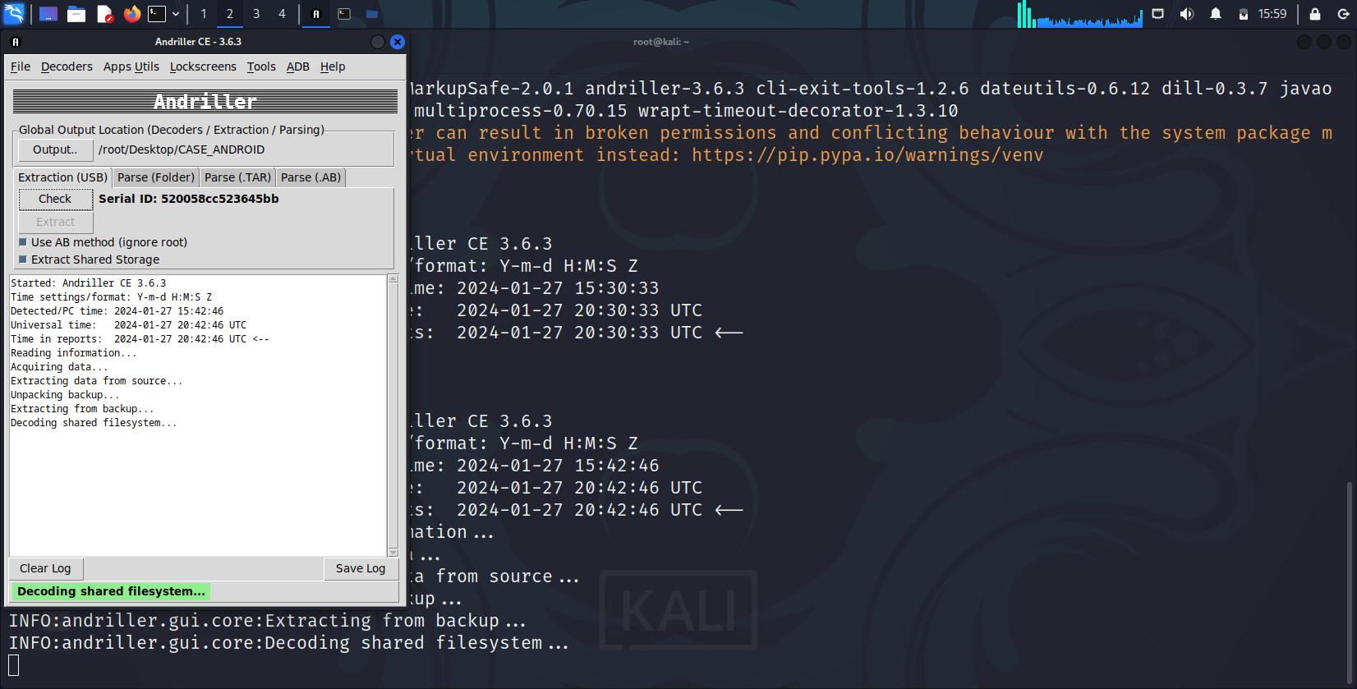
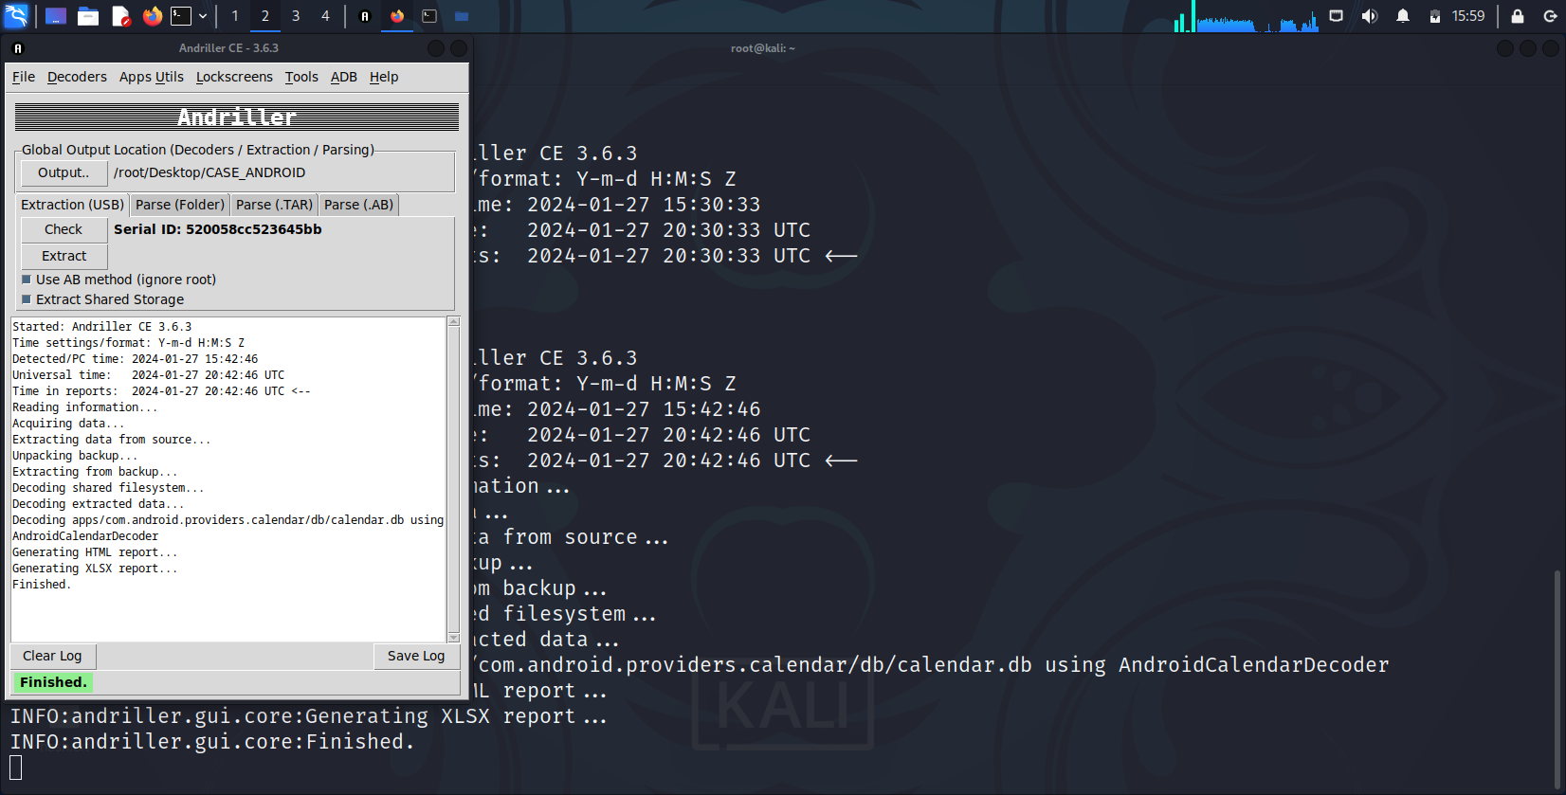
Using
ANDRILLER

Slide 9
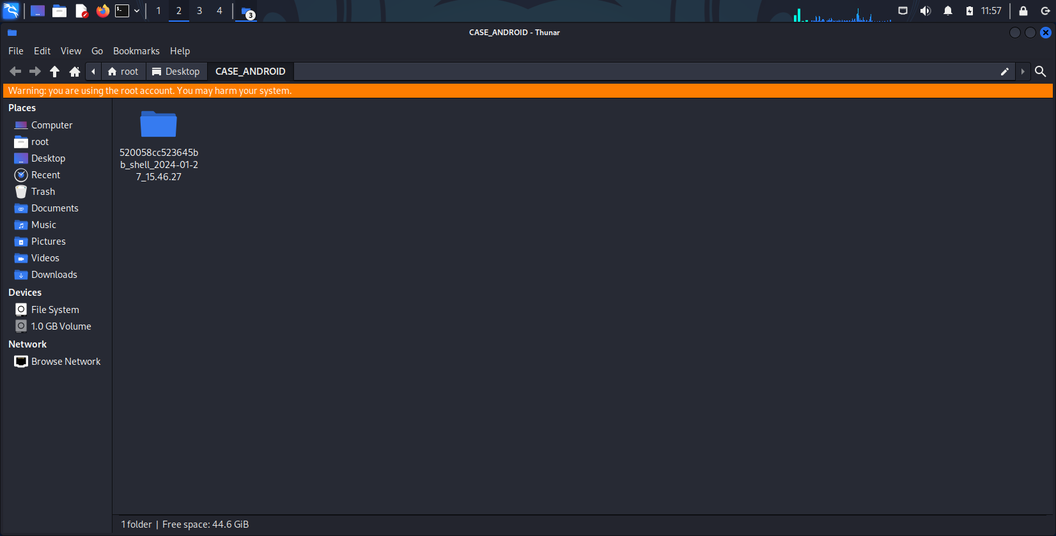

Slide 10
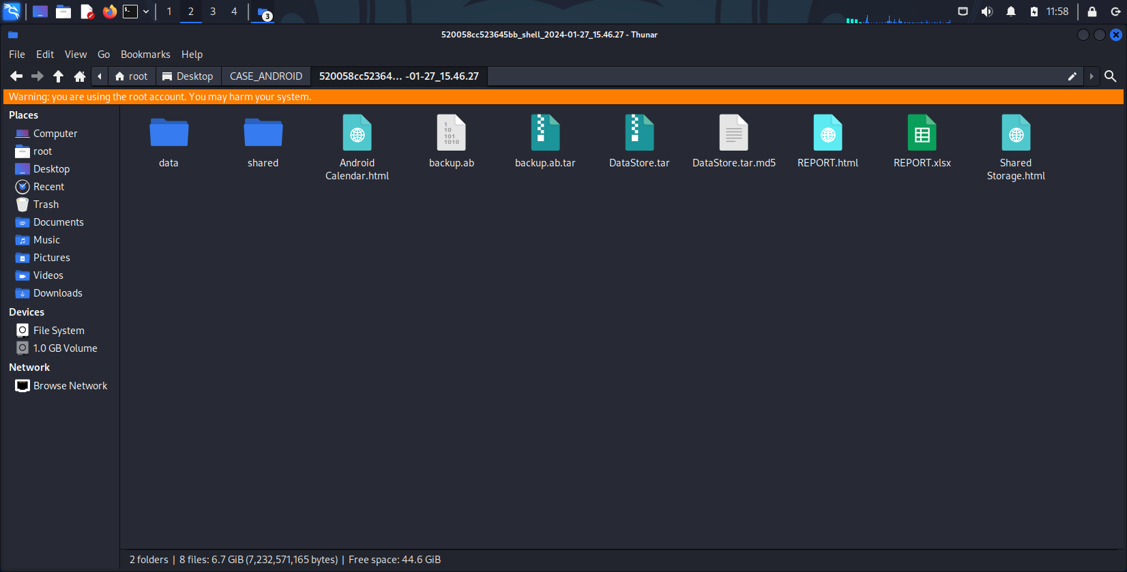

Slide 11
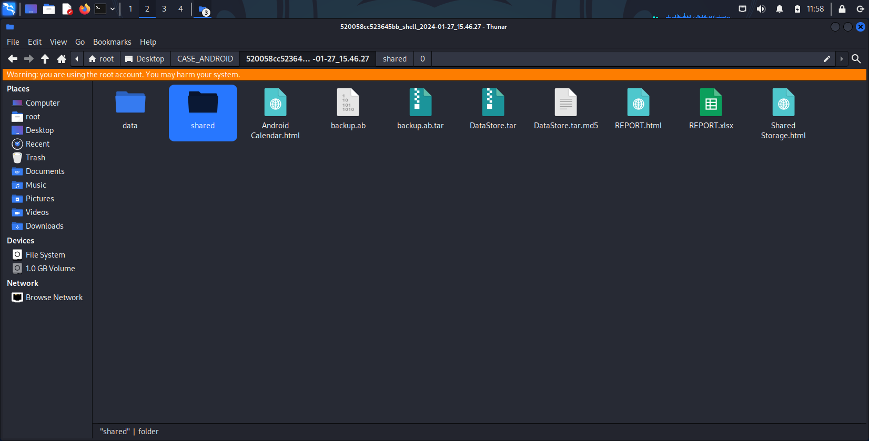

Slide 12
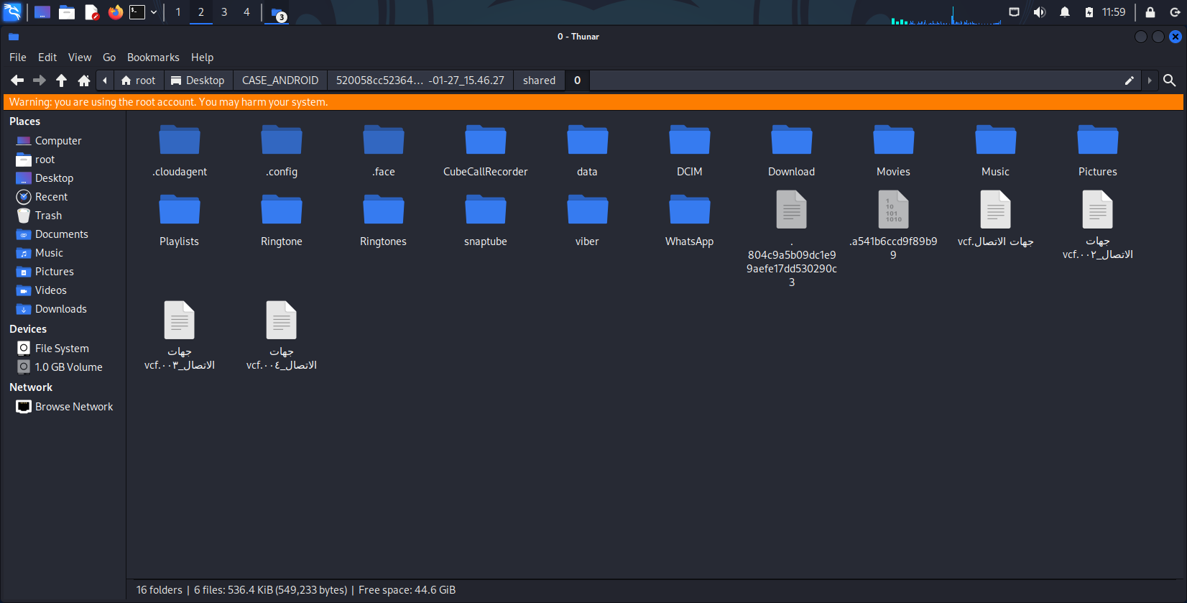

Slide 13
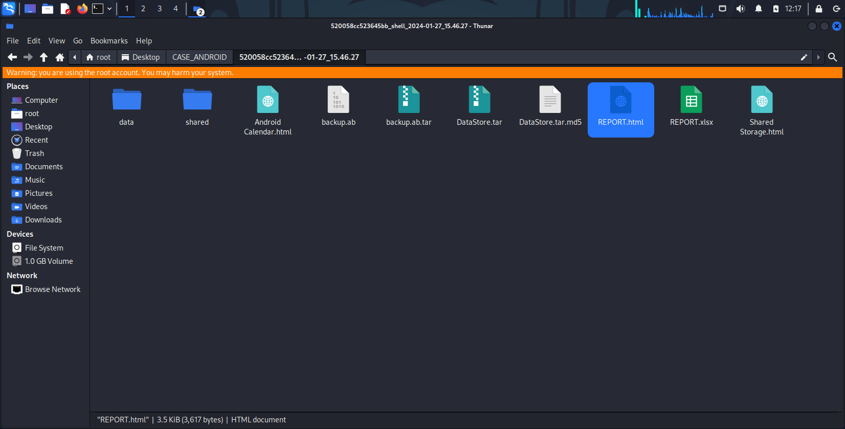

Slide 14
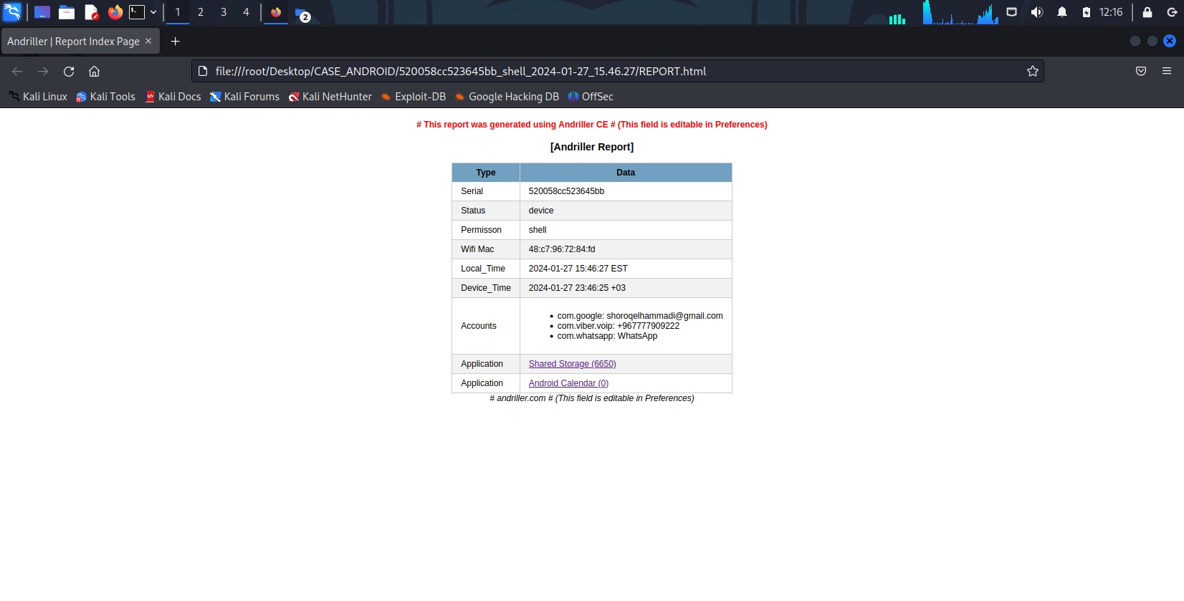

Slide 15
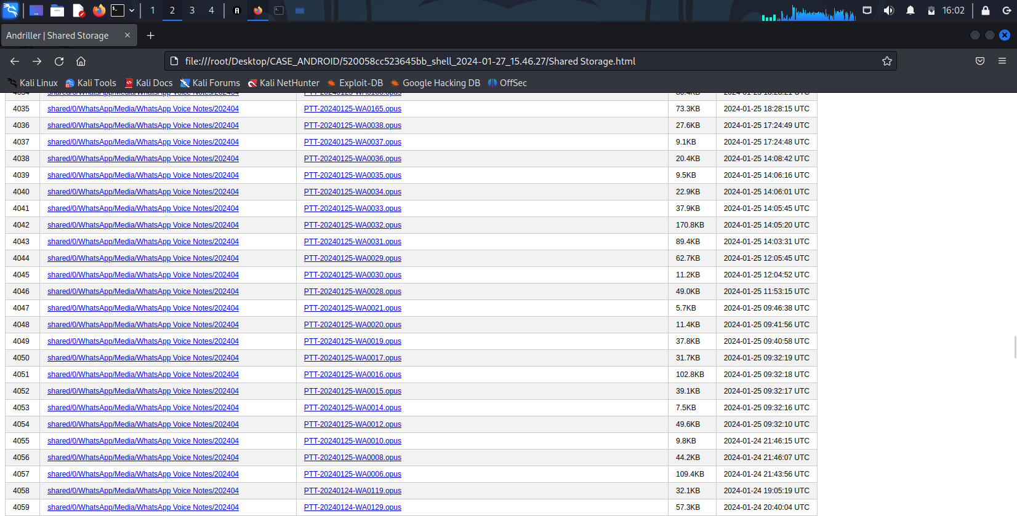

Slide 16
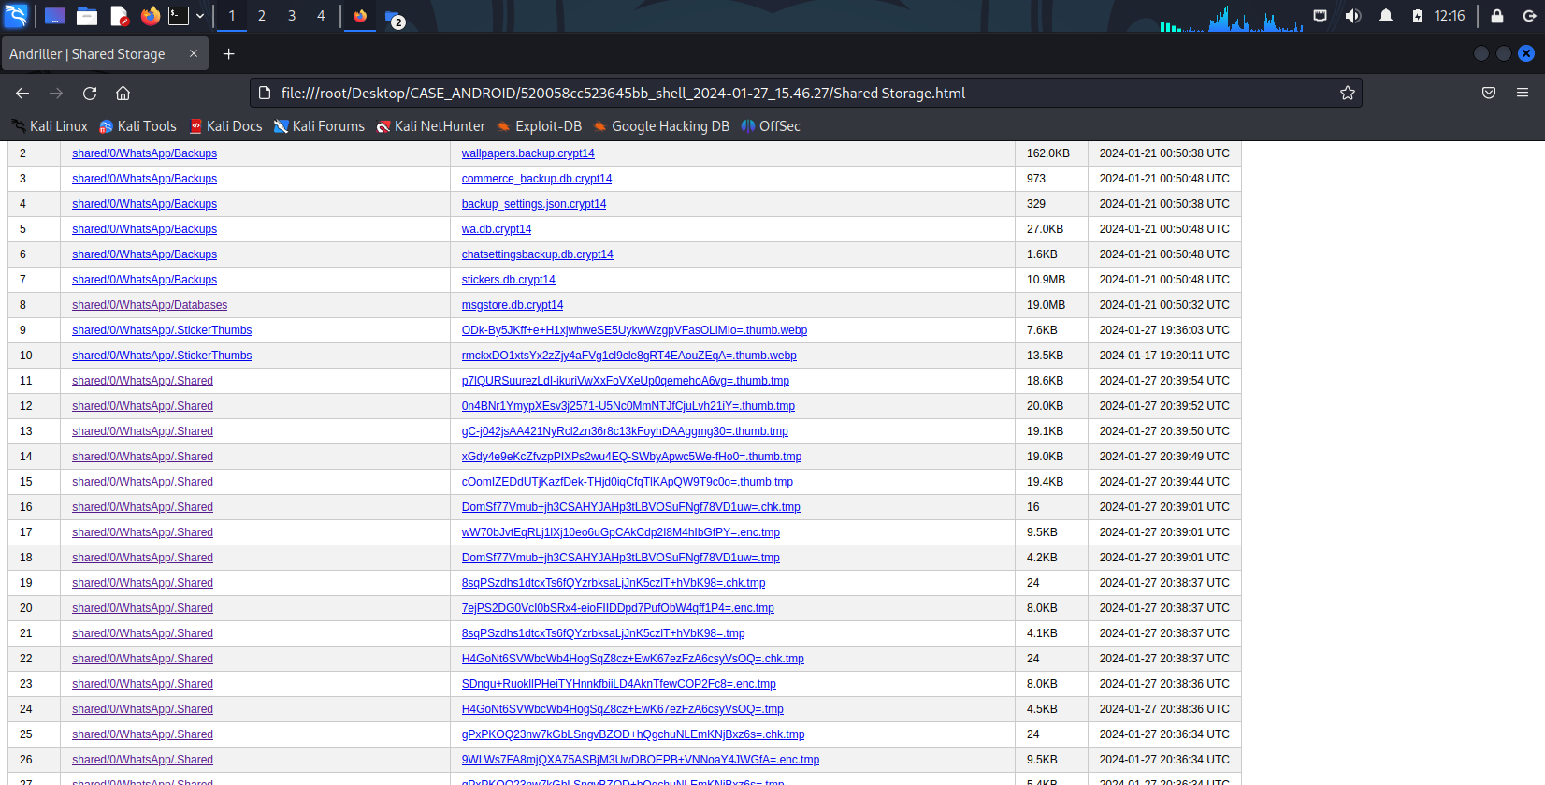

Slide 17
THE STAGE HAS BEEN SET go ahead and follow the basic 5 steps
1
2
3
4
5
Understand your brand and audience; speak in an authentic voice
Get your facts straight with 5 W’s
The power of specifics, details, and imagery
Show, don’t tell
Know the end at the beginning

Slide 18
PhoneRescue

Slide 19
PhoneRescue
- يستخدم برنامج PhoneRescue لاستعادة البيانات المفقودة أو المحذوفة من الأجهزة الذكية.
يعتبر برنامج PhoneRescue سهل الاستخدام بحيث يدعم اللغة العربية.
أيضا يقوم بتوفير نسخة خاصة Android
ونسخة خاصة iOS

Slide 20
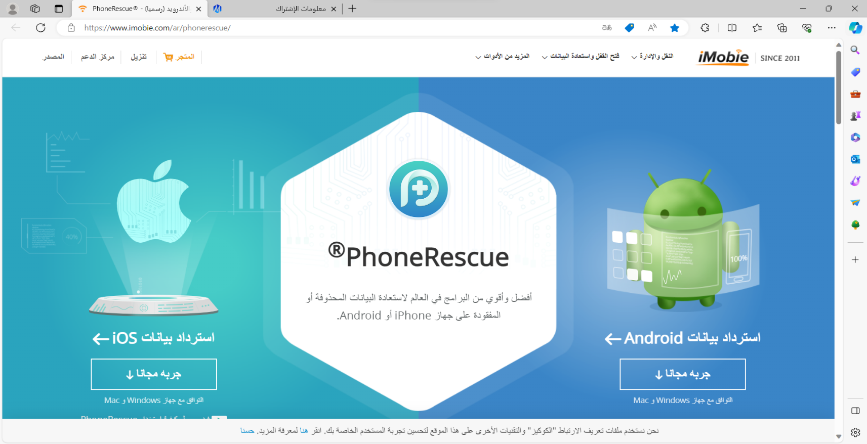
PhoneRescue
- موقع تنزيل البرنامج عبر الرابط :www.imobie.com

Slide 21
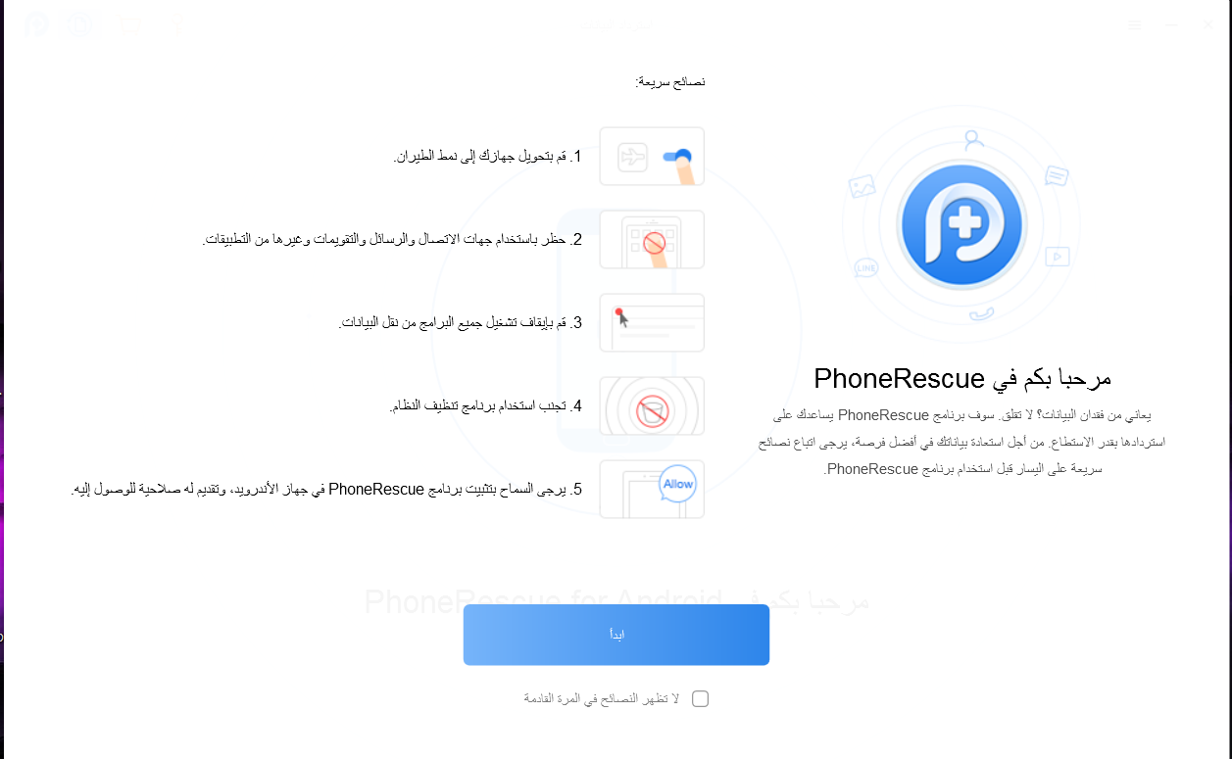

Slide 22
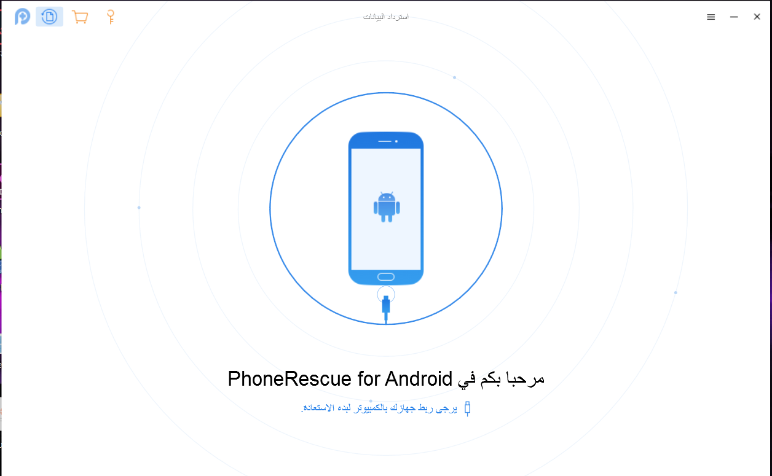

Slide 23
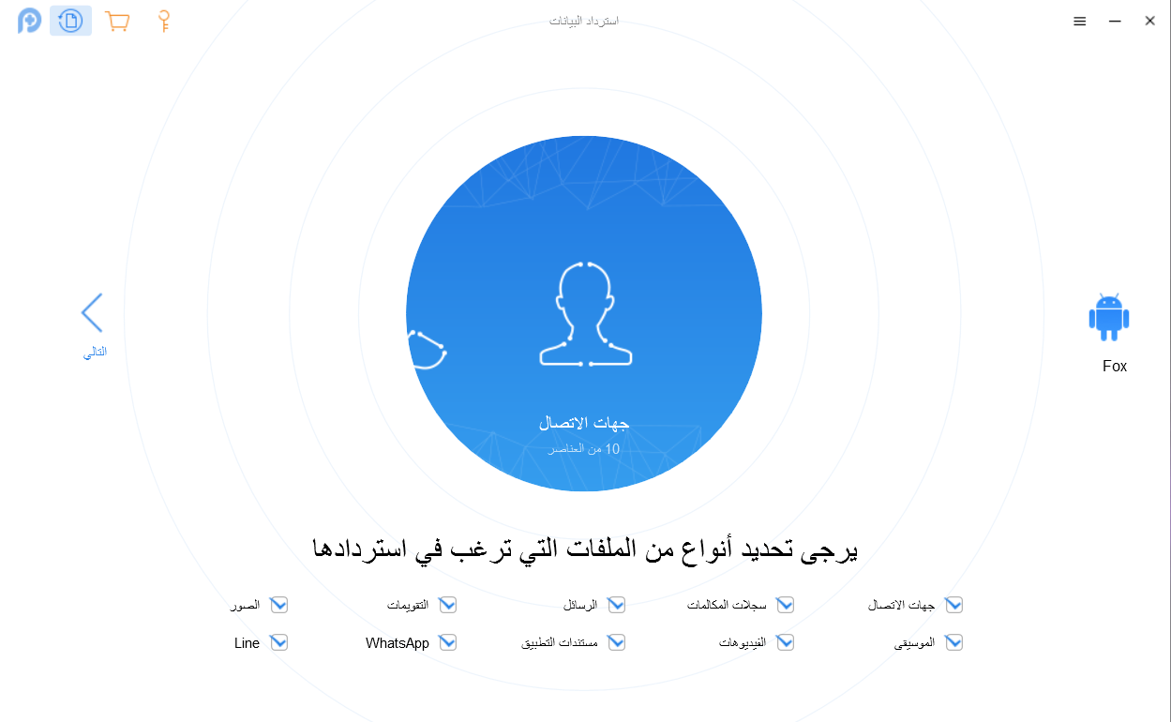

Slide 24
PhoneRescue
- أنواع الملفات الذي تستطيع استردادها :
5- الصور
4- الرسائل
3- الفيديوهات
2- سجلات المكالمات
1- جهات الاتصالات
10- التقويم
9- WhatsApp
8- Line
7- مستندات التطبيق
6- الموسيقى

Slide 25
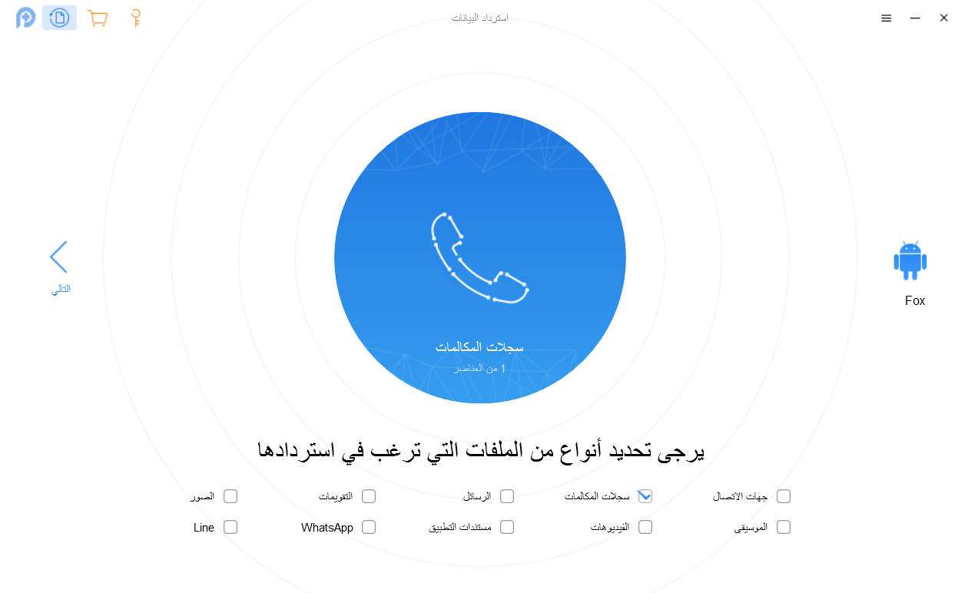

Slide 26
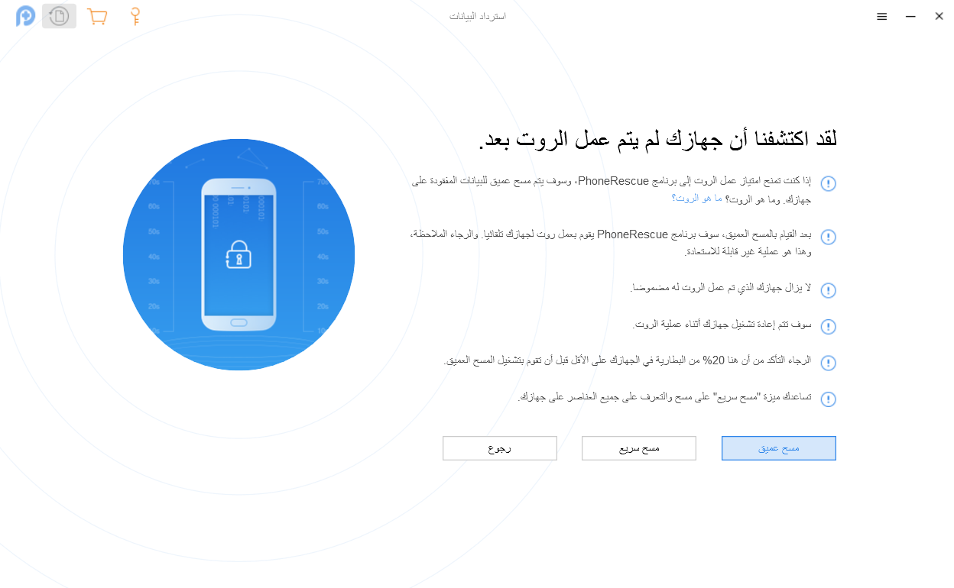

Slide 27
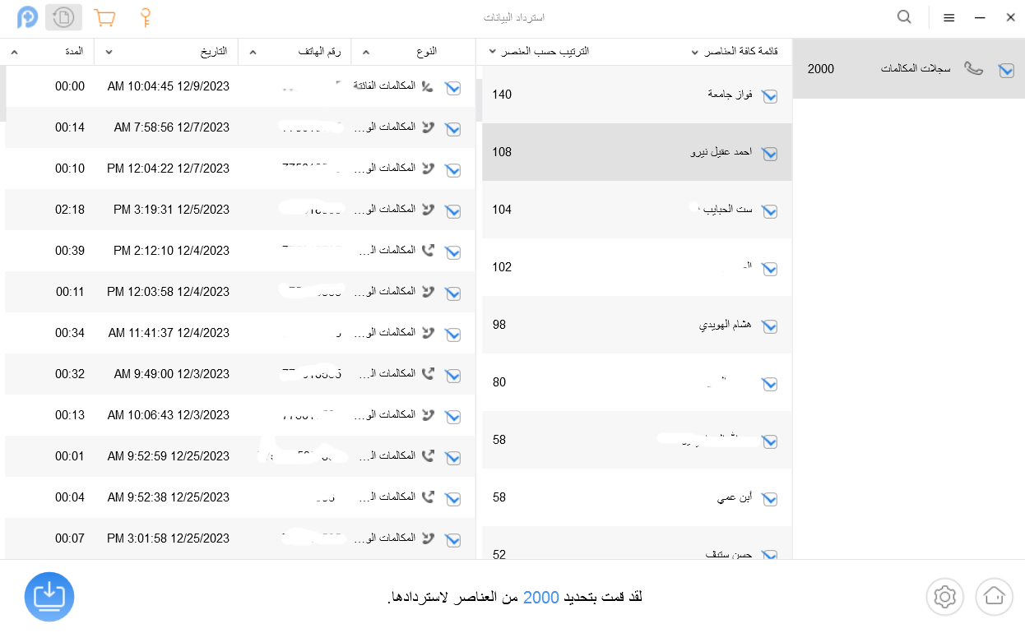

Slide 28
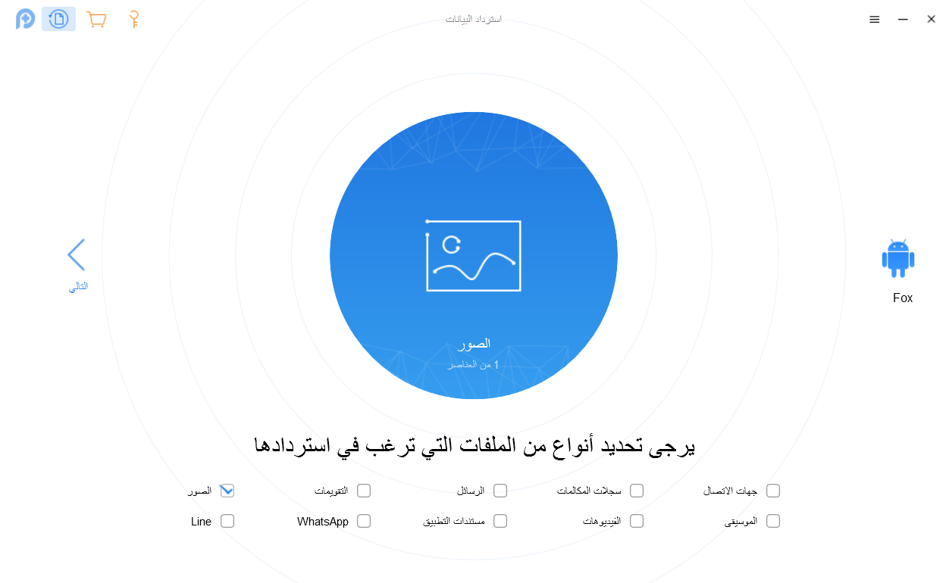

Slide 29
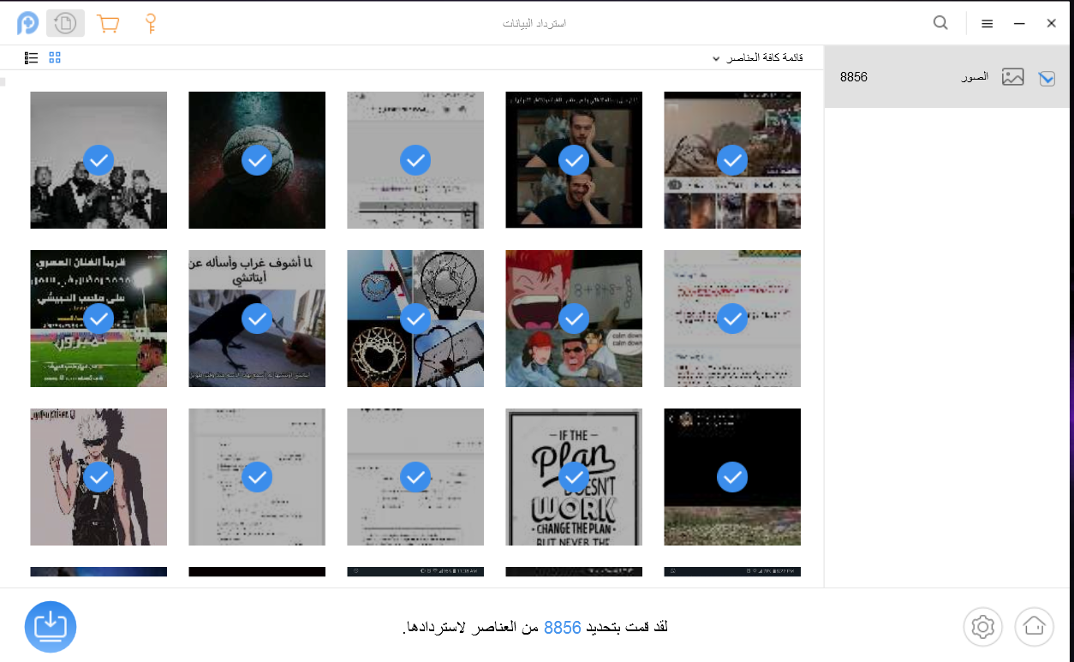

Slide 30
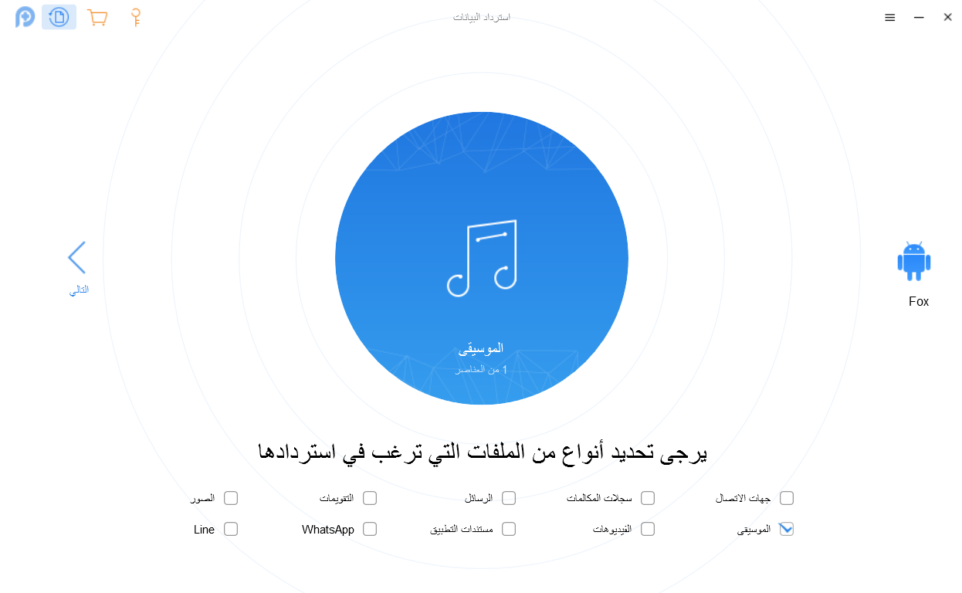

Slide 31
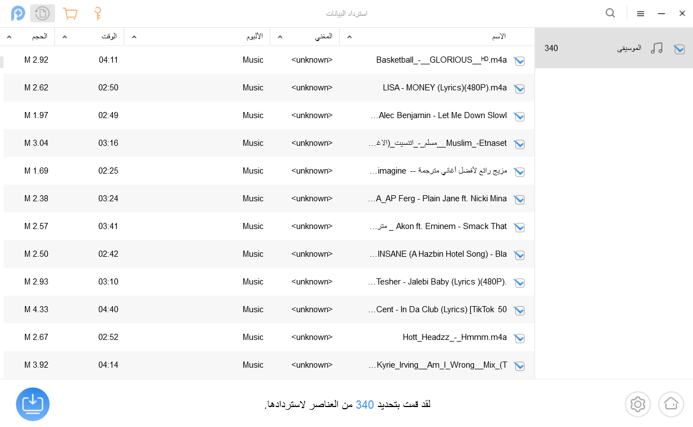

Slide 32
Lethal Company Team!
THANK YOU
Neal Creative | click & Learn more

